Slide 1
Bank Subscription Predictor

Slide 2
Plan
01
02
03
04
05
Dataset explanation
Data cleaning
Learning algorithm implementation
Implementation of the learning algorithm
Interpreting the results
06
Selection of the Best Learning Algorithms
07
Conclusion

Slide 3
Introduction
Our project aims to optimize telemarketing campaigns by using AI to classify customers' eligibility for a Term Deposit account.
The AI will predict whether a customer is likely to subscribe based on key demographic, financial, and campaign-related indicators.
If the customer meets the criteria, the AI will classify them as "eligible" for the banking investment product: Term Deposit account.
We will identify the most impactful features for classification and provide a tool that allows clients to check their eligibility by entering these indicators. This solution enhances decision-making and improves marketing efficiency.

Slide 4
01
Dataset explanation

Slide 5
Dataset explanation
Bank Marketing dataset, the objective is to forecast, using a range of demographic, financial, and campaign-related characteristics, whether a client would sign up for a term deposit (y).
The columns are broken out as follows:
age: Age of the client.
job: Job type (e.g., "admin.", "blue-collar", "technician").
marital: Marital status (e.g., "single", "married", "divorced").
education: Education level (e.g., "primary", "secondary", "tertiary").
default: Whether the client has credit in default (binary: "yes" or "no").
housing: Whether the client has a housing loan (binary).
loan: Whether the client has a personal loan (binary).
contact: Contact communication type (e.g., "cellular", "telephone").
day_of_week: Last contact day of the week (e.g., "mon", "tue").

Slide 6
Dataset explanation
duration: Last contact duration, in seconds (numeric).
campaign: Number of contacts performed during this campaign for this client (numeric).
pdays: Number of days since the client was last contacted from a previous campaign.
previous: Number of contacts performed before this campaign for this client (numeric).
poutcome: Outcome of the previous marketing campaign (e.g., "failure", "success").
emp.var.rate: Employment variation rate (numeric, quarterly indicator).
cons.price.idx: Consumer price index (numeric, monthly indicator).
cons.conf.idx: Consumer confidence index (numeric, monthly indicator).
euribor3m: Euribor 3-month rate (numeric, daily indicator).
nr.employed: Number of employees (numeric, quarterly indicator).
y: Target variable - whether the client subscribed to a term deposit (binary: "yes" or "no").

Slide 7
02
Data cleaning

Slide 8
Identify problems in the data
Issues with missing or unknown values
A
B
Problem of Outliers
Detected Problems
Class imbalance [y]
C
D
Structure and clarity of the columns

Slide 9
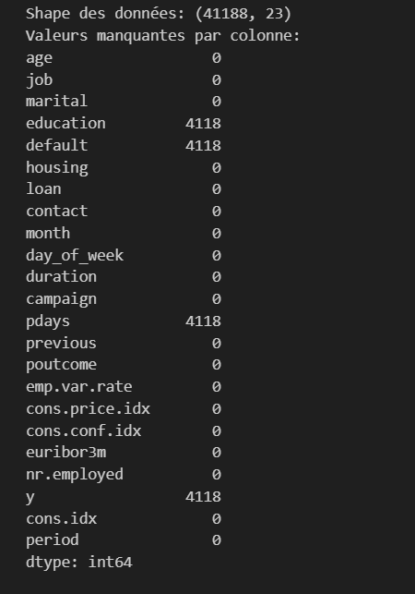
Missing Values ​​Problem
# Data Overview:
Missing Values ​​by Column

Slide 10
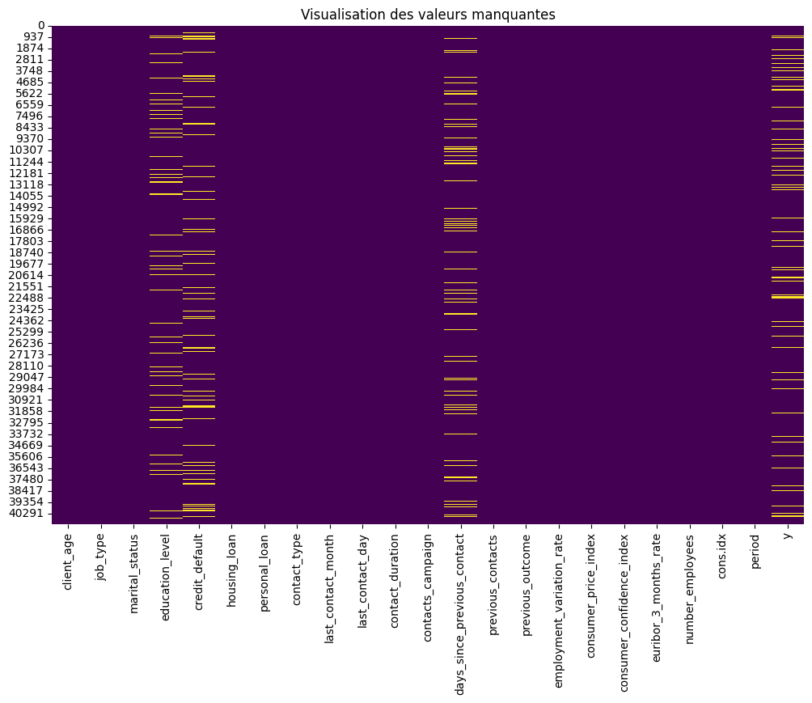

Slide 11
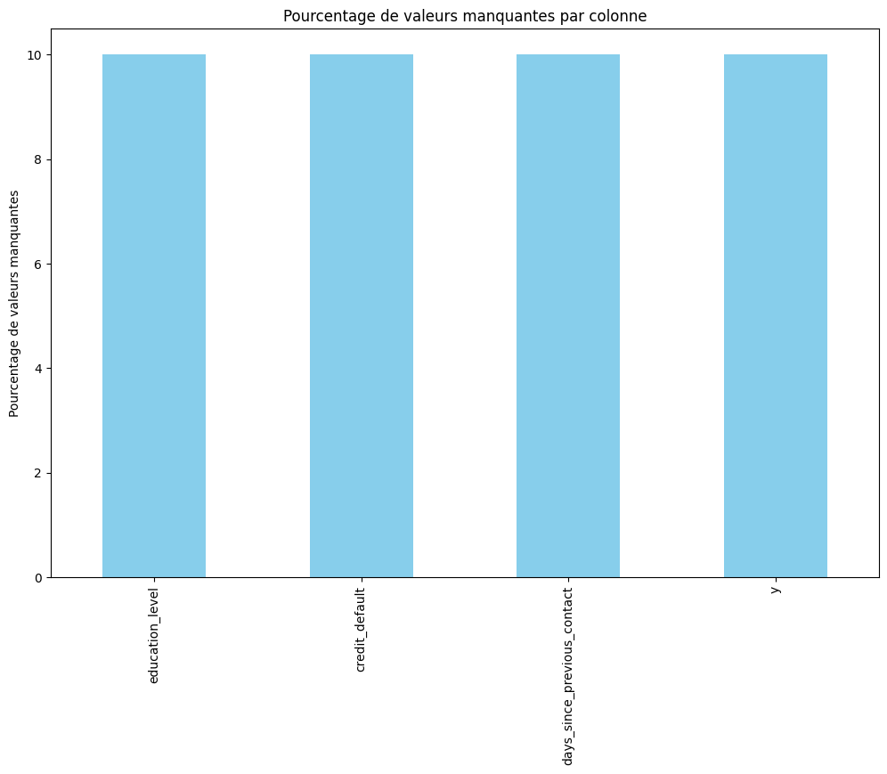
Percentage of missing values ​​per column::
A bar chart was used to quantify the most affected columns..

Slide 12
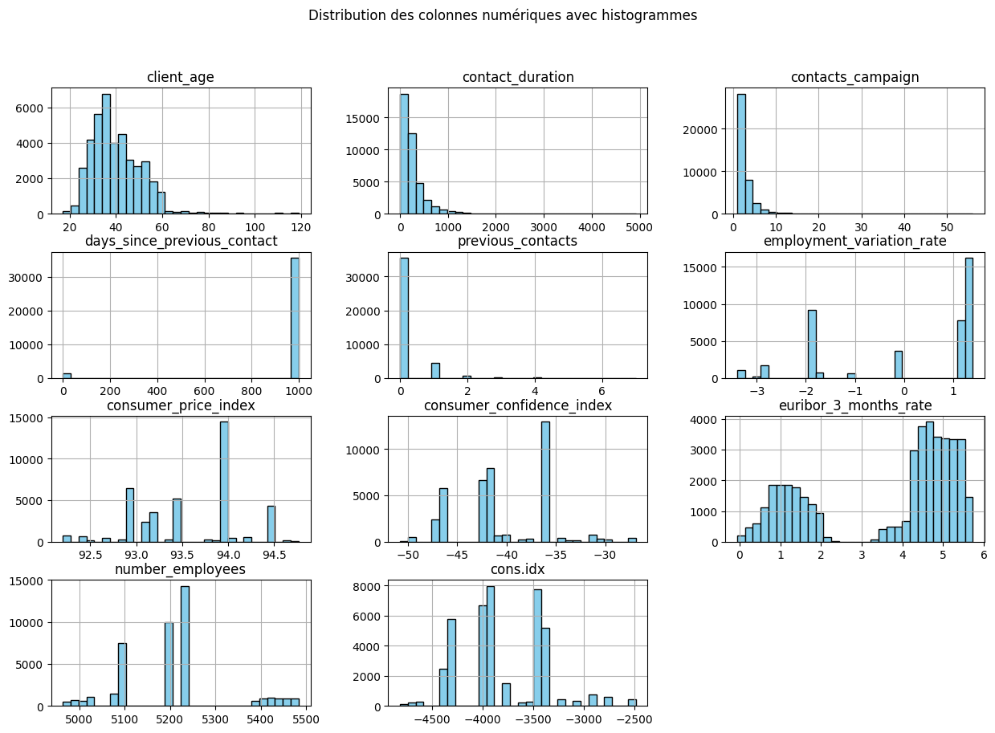

Slide 13
Fixing the missing values ​​problem
Implemented Solution:
Numerical Columns:
Use of KNNImputer to fill missing values in numerical columns.
The KNNImputer estimates missing values based on similar rows, providing more accuracy compared to using the mean or median.
Categorical Columns:
Replacement of missing values with the mode (most frequent value) to ensure category consistency.
Result :
All missing values in both numerical and categorical columns have been replaced.
Verification: After imputation, a check was performed to ensure that the dataset no longer contains any missing values.

Slide 14
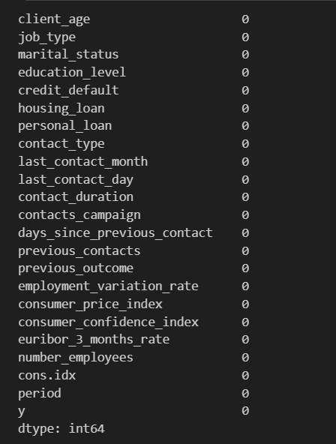
Fixing the missing values ​​problem
# Checking for missing values ​​after imputation

Slide 15
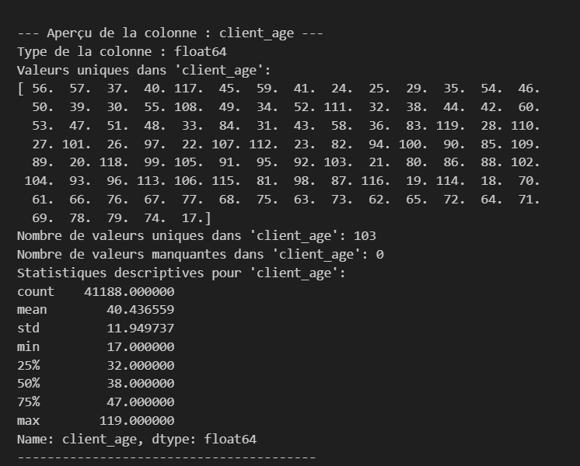
Outlier Problem
Problem :
Some values, such as ages below 17 or above 100, were deemed implausible. These values were considered outliers and could disrupt data analysis.
Impemented solution: To correct these outliers, we applied realistic thresholds based on the defined business rules:
Ages below 17 were adjusted to 17.
Ages above 100 were adjusted to 100.
The method used is the np.clip() function, which "clips" (or limits) values to a given range.

Slide 16
Problems with unknown values:
Problem : In categorical columns such as job_type, marital_status, education_level, etc., there were "unknown" values that provide no useful information for analysis. These missing values could bias the analysis and harm the modeling process..
Implemented solution : To address this issue, we replaced the "unknown" values with the most frequent value (mode) of each column. This approach ensures that missing values are replaced with logical values, rather than being ignored or left as "unknown".
Add a binary column indicating whether the customer has been contacted before
Problem : The column days_since_previous_contact contained values, notably 999, indicating that no contact had taken place. However, it was not clear whether the customer had been contacted previously.
Implemented solution: We created a new binary column, previous_contacted, indicating whether the customer had been contacted before, based on the value of days_since_previous_contact.
Explication: The condition days_since_previous_contact != 999 identifies customers who have been contacted, and .astype(int) converts this information into a binary column with 1 for "contacted" and 0 for "not contacted".

Slide 17
One-Hot Encoding of Categorical Variables
Problem : Categorical columns contain qualitative values (e.g., job_type, marital_status, etc.), but these values cannot be directly used in machine learning models without being transformed into numerical variables.
Solutionimplémentée : We used One-Hot encodage to convert the categorical columns to numeric variables. This creates a new column for each modality, where each row is marked with 1 or 0 depending on the modality present.
Converting target variable y to binary
Problem : The y column (the target variable) consisted of text values "yes" and "no", which is not directly usable in machine learning models.
Implemented Solution: We converted the text values "yes" and "no" to binary values 1 and 0

Slide 18
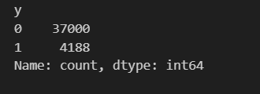
Class Imbalance
Problem
The dataset has a marked class imbalance, with 88% of class "0" (unsubscribed) and only 12% of class "1" (subscribed), which may bias the model's predictions.
Proposed solution
The SMOTE method was applied to generate synthetic examples for the minority class. This helps balance the classes in the training set, improving the model's ability to predict the underrepresented class.
Notes:
Explication :
Le OneHotEncoder est utilisé pour transformer les colonnes catégorielles en colonnes binaires. Par exemple, si une colonne job_type a les modalités "admin", "technician", "services", l'encodage One-Hot crée trois colonnes : job_type_admin, job_type_technician, job_type_services, avec des valeurs 1 ou 0.
L'option drop='first' permet d'éviter la redondance en supprimant la première colonne de chaque groupe d'encodage, ce qui évite la multicolinéarité.
Résultat : Les colonnes catégorielles ont été transformées en variables numériques, ce qui permet aux modèles de machine learning de les utiliser efficacement.

Slide 19
Rename and structure columns for better clarity
Problem :
The column names in the original dataset were not sufficiently descriptive (e.g., age, job, marital).
Implemented Solution :
Renamed columns with clearer and more descriptive names:
age → client_age
job → job_type
marital → marital_status
The target column y has been moved to the last position to improve the organization of the dataset.
Result :
Better readability and understanding of the dataset, facilitating analysis and modeling.
Notes:
Explication :
Le OneHotEncoder est utilisé pour transformer les colonnes catégorielles en colonnes binaires. Par exemple, si une colonne job_type a les modalités "admin", "technician", "services", l'encodage One-Hot crée trois colonnes : job_type_admin, job_type_technician, job_type_services, avec des valeurs 1 ou 0.
L'option drop='first' permet d'éviter la redondance en supprimant la première colonne de chaque groupe d'encodage, ce qui évite la multicolinéarité.
Résultat : Les colonnes catégorielles ont été transformées en variables numériques, ce qui permet aux modèles de machine learning de les utiliser efficacement.

Slide 20
03
Learning algorithm implementation

Slide 21

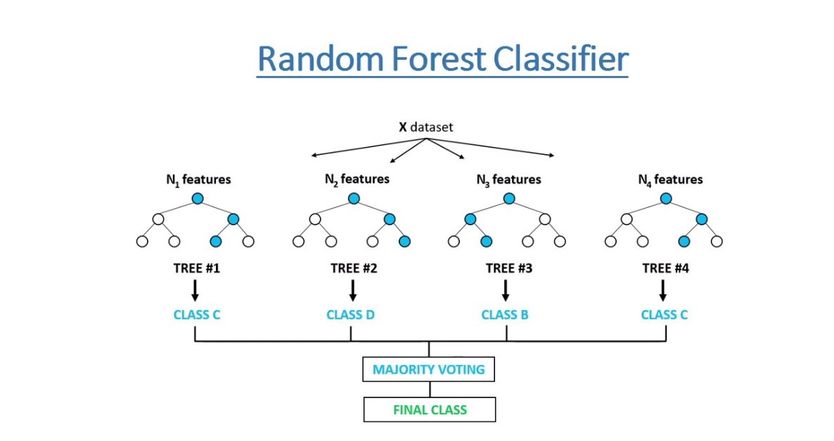
Random Forest
Random Forest can be used to solve classification problems. ​
Feature selection is possible with Random Forests.
Random Forest prevents overfitting by creating trees within the forest randomly.
Random Forest is an ensemble of multiple decision trees.

Slide 22
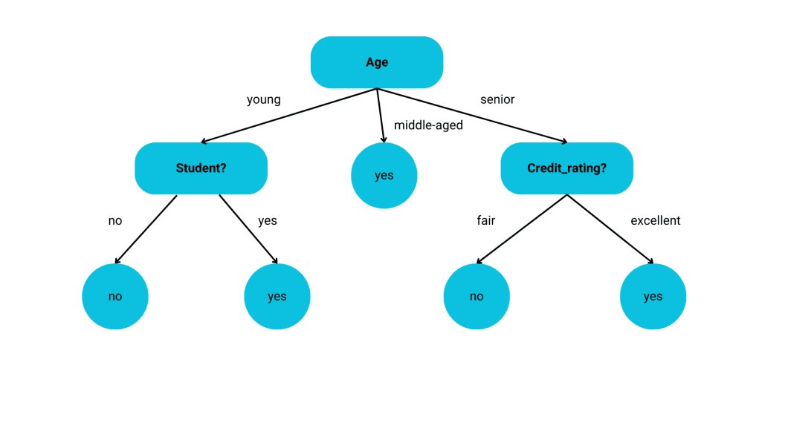
Decision Tree​
Main Algirithm: DecisionTreeClassifier
Easy to interpret.
Effective for data with non-linear relationships.
Handles both numerical and categorical columns well.
Trains models quickly, even on relatively large datasets.

Slide 23
04
Implementation of the learning algorithm

Slide 24


Slide 25
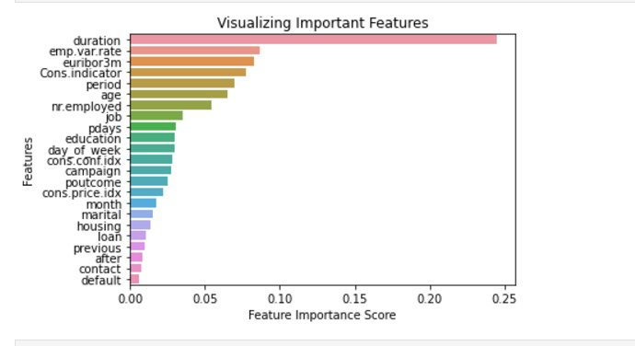
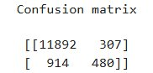
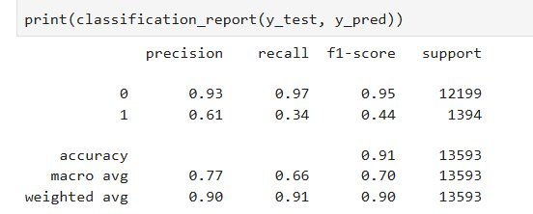
Scenario 1​[ Random Forest ]
Default settings (n_estimators = 100 & random_state=0)
All features
Accuracy | Precision | Recall | F1-score
0.9102 | 0.93 0.61 | 0.97 0.34 | 0.95 0.44

Slide 26
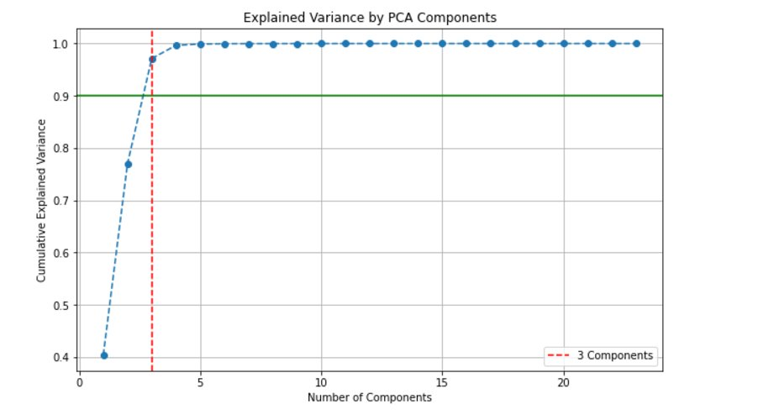
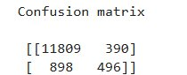
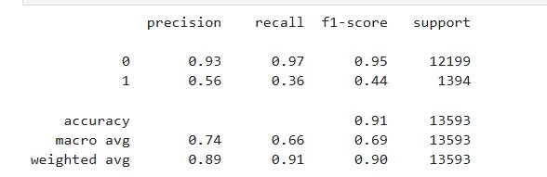
Scenario 2 [ Random Forest ]
Parameters: (n_estimators = 300 & random_state=0)
5 features selected (Variance 100%)
​
Number of components needed to achieve 100.0%
variance: = > 5
Accuracy | Precision | Recall | F1-score
0.9052 | 0.93 0.56 | 0.96 0.35 | 0.95 0.43
1-Last contact duration
2-Employment variation rate
3-Consumer confidence index
4-Euribor
5-period = 5th place = 0.069454

Slide 27
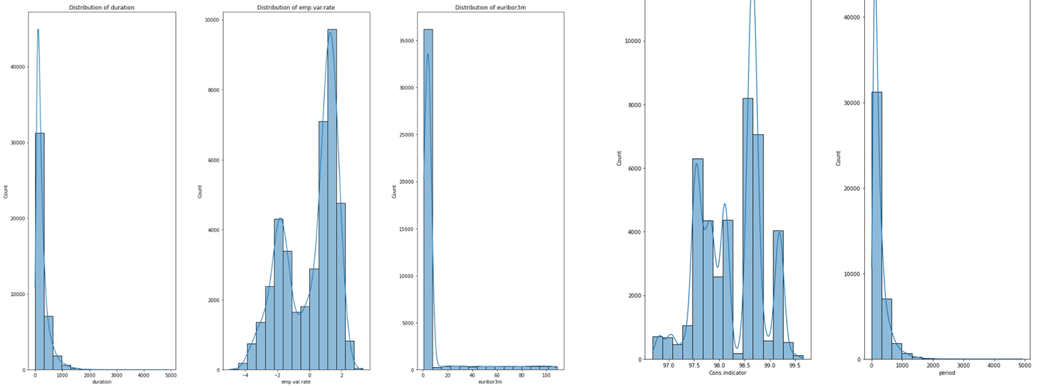
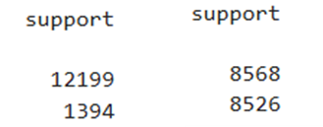
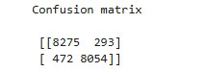
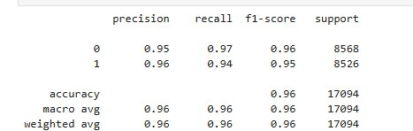
Scenario 3 [ Random Forest ]
Parameter: n_estimators = 300 & random_state=0)
5 Selected features = 5 hightest Score
Normal distribution
Balanced data
​
Accuracy | Precision | Recall | F1-score
0.9552 | 0.95 0.96 | 0.97 0.94 | 0.96 0.95

Slide 28
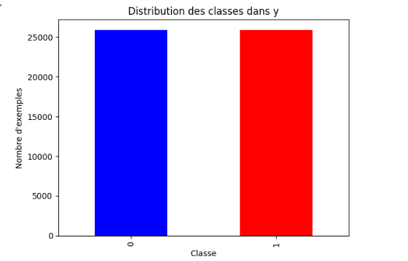
Scenario 1 [ Decision Tree ]
​
Dataset équilibré​
Parameters used ​
critiron | Depth | random_state
GINI | 3 | NaN ( 0 )
Results obtained
Score​ | Accuracy | Training set score | Test set score
0.8449​ | 0.8474 | 0.8474 | 0.8449

Slide 29
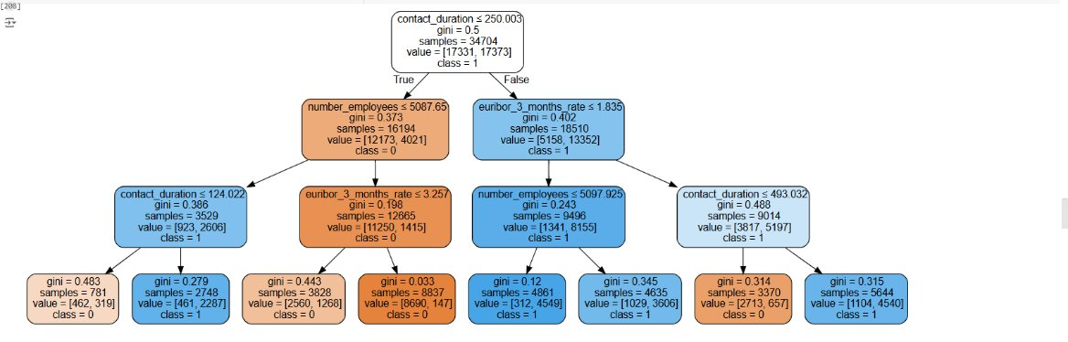
Scenario 1 [ Decision Tree ]
​

Slide 30
Scenario 2 [Decision Tree ]
​
​
Parameters used
​ critiron | Depth | random_state
ENTROPY | 3 | NaN ( 0 )
Results obtained
Score​ | Accuracy | Training set score | Test set score
0.8326 | 0.8320 | 0.8320 | 0.8326

Slide 31
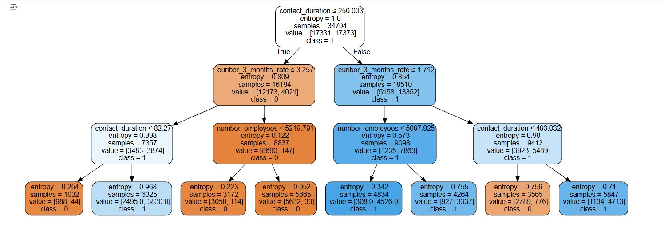
Scenario 2 [Decision Tree ]
​

Slide 32
04
Interpretation of results

Slide 33
Results :[ Random Forest ]
Simulation | Accuracy | Precision | Recall | F1-score
Scenario1 | 0.9102 | 0.93​ 0.61​ | 0.97​ 0.34​ | 0.95​ 0.44​
Scenario2 | 0.9129​ | 0.93​ 0.64​ | 0.98​ 0.34​ | 0.93​ 0.45 ​
Scenario3 | 0.9052​ | 0.93​ 0.56 | 0.96​ 0.35​ | 0.95​ 0.43​
Scenario4 | 0.9552​ | 0.95​ 0.96 | 0.97​ 0.94​ | 0.96​ 0.95​

Slide 34
Comparison between the two scenarios:[DecisionTree]​
# | GINI | ENTROPY
Score | 0.8449​ | 0.8326​
Precision | 0.8474​ | 0.8320​
Training score | 0.8474​ | 0.8320​
Test score | 0.8449​ | 0.8326​

Slide 35
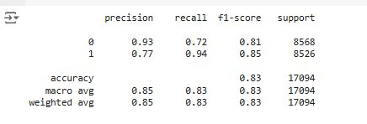
Paramètres utilisés:[Decision Tree ]​
critiron | Depth | Min_samples_leaf | Min_samples_split​ | Random State
GINI | 5​ | 2​ | 10​ | NaN ( 0 )
Results obtained:

Slide 36
05
Selection of the best algorithm

Slide 37
Algorithm used | Accuracy
Random Forest | 0.9552​
Decision Tree | 0.8320

Slide 38
Conclusion
The solution implemented will allow the bank to effectively identify customers potentially interested in this banking investment product.
However, further work will need to be done to identify other types of customer data that could improve our model and even consider the possibility of enriching the model with the classification of customers on the interest of renewing banking investment contracts via the same model.
This work will allow us to improve the distribution model of this banking product.

